Slide 1


The impact of Technology and Media (mass and social) in the home
TEXT: I Cor 10:23
By Bro. Emmanuel Anuge

Slide 2

LESSON OBJECTIVES
The objectives of the lesson are;
Understanding technology and media
Identify challenges posed by technology & media on the family
Discuss potential impact on our homes
Discuss how to strike a balance in managing the use of media and technology without distorting family values.

Slide 3


INTRODUCTION -What is Technology?
Technology id not only electronics and digital devices.
Technology is taking the patterns and elements of our created world to amplify our abilities, allowing us to do more, faster, and better than we could in our own strength.
A shovel is a piece of technology as well as a GPS-guided tractor.
Every age has a certain level of technology. Construction projects from the bible depicting advanced technology. Genesis 6 (The Ark), I Kings 6 (Building of the temple)

Slide 4

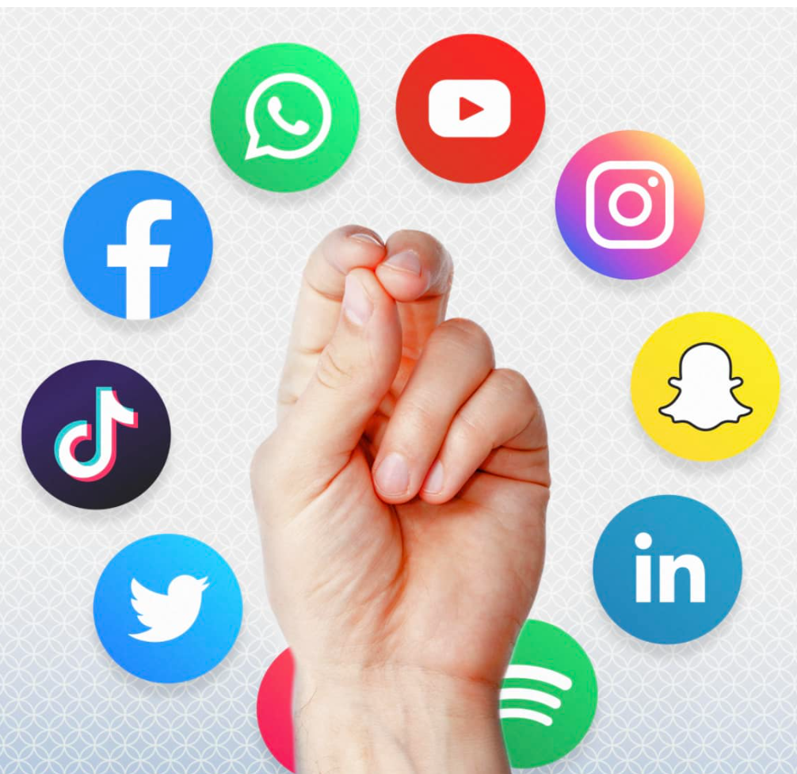
INTRODUCTION -Mass vs Social media
Mass media: focuses on delivering news to the general public or a targeted group of the public.
The term “social media” is used to describe a variety of different digital platforms

Slide 5
Statistical records of social media use today
More than three-quarters of internet users are on social networking sites,
The average person spends almost 143 minutes on social media every day.
Approx. 16.6 hours every week.
- 61.8% of the world population use social media – I.e one in every 2 persons you meet.
Facebook: Over 2.9 billion users. Largest age group – 25-34 yr-olds.
- Instagram: Over 2 billion users. 25-34 yr-olds with 18-23 yr-olds running a close 2nd.
TikTok: Over 1.2 billion users.
Twitter: 619 million users. 13-17 (2.4%), 18-24 (34.2%), 25-34 (36,6%), 35-49 (19.7%)
Pinterest: 431 million users.
Snapchat: Over 400 million. 15-25 yr-olds dominant
YouTube: About 2 billion users. 15-35 yr-olds.

Slide 6
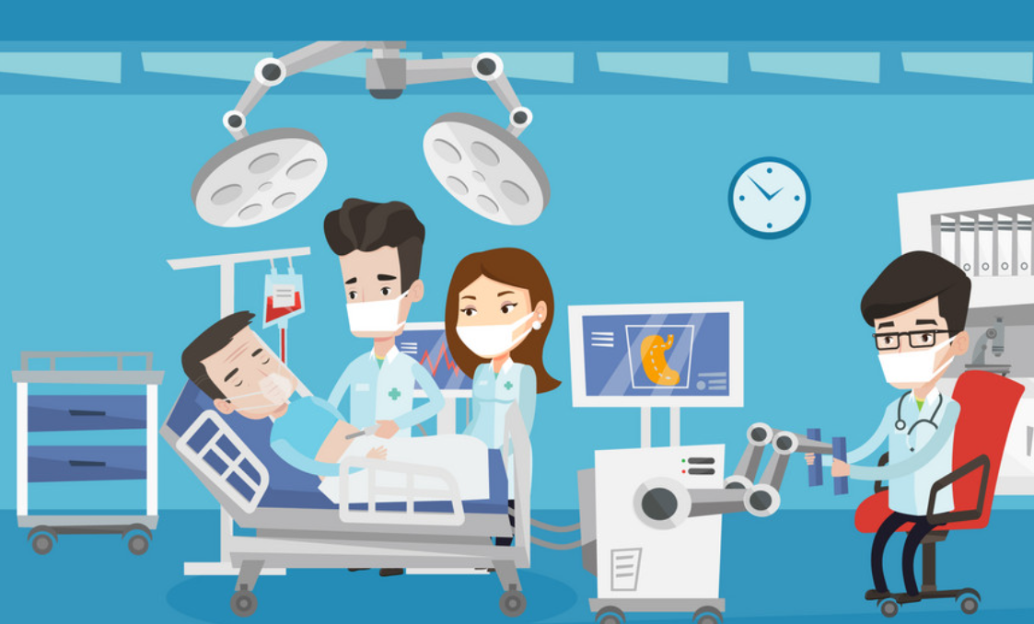

Technology & Media itself is neither good or evil…it all comes down to how it is used.

Slide 7

The Potential Benefits of Technology & Media
Technology and Media has significantly enriched family life in various ways. Here are some positive aspects of technology in the home:
Enhanced Communication
Educational Resources
Convenience and Efficiency
Entertainment Options
Health and Wellness
Remote Work and Learning
Support Networks
What is our focus? benefits or negative impact on the home?

Slide 8
NEGATIVE IMPACT OF TECHNOLOGY AND SOCIAL MIDEA
Exposure to Inappropriate Content & Negative Influences
Children (Psalms 127:3-5 - A heritage from God) To be guarded and protected.
A Childs access to unfiltered, unsupervised access to technology and social media, a gate code for Satan's invitation to invade and destroy.
e.g. with just 2 clicks, they can be exposed to some of the most vile, graphic images & videos imaginable.
Average age of child’s first exposure to ponography is 11 yrs. old.

Slide 9
At what age should a child own a smart phone or computer with acces to the internet?
What is the appropriate TV time a child should have? Do we care enough to pay attention?
Adults
We mindlessly & constantly fill our minds with images & information that is not true, honorable, just, pure, lovely, commendable, excellent, & worthy of praise, we are not guarding the gates to our lives & the enemy is coming in as quickly & as aggressively as he can.

Slide 10

Be careful what you ingest into your minds. It defines our actions. We must guard it.
Prov 4:23: Guard your hearts with all diligence.
Mind what you read, listen to and watch

Slide 11


Slide 12
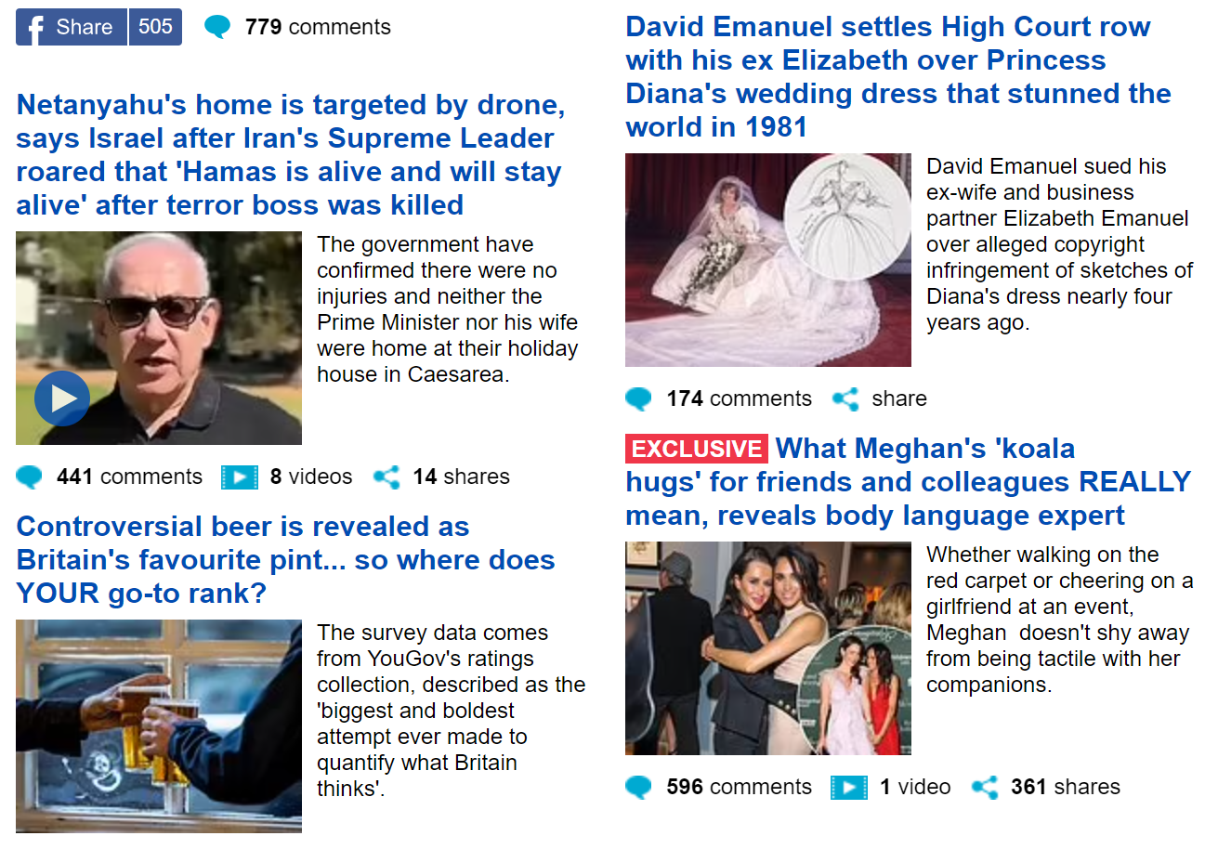

Slide 13
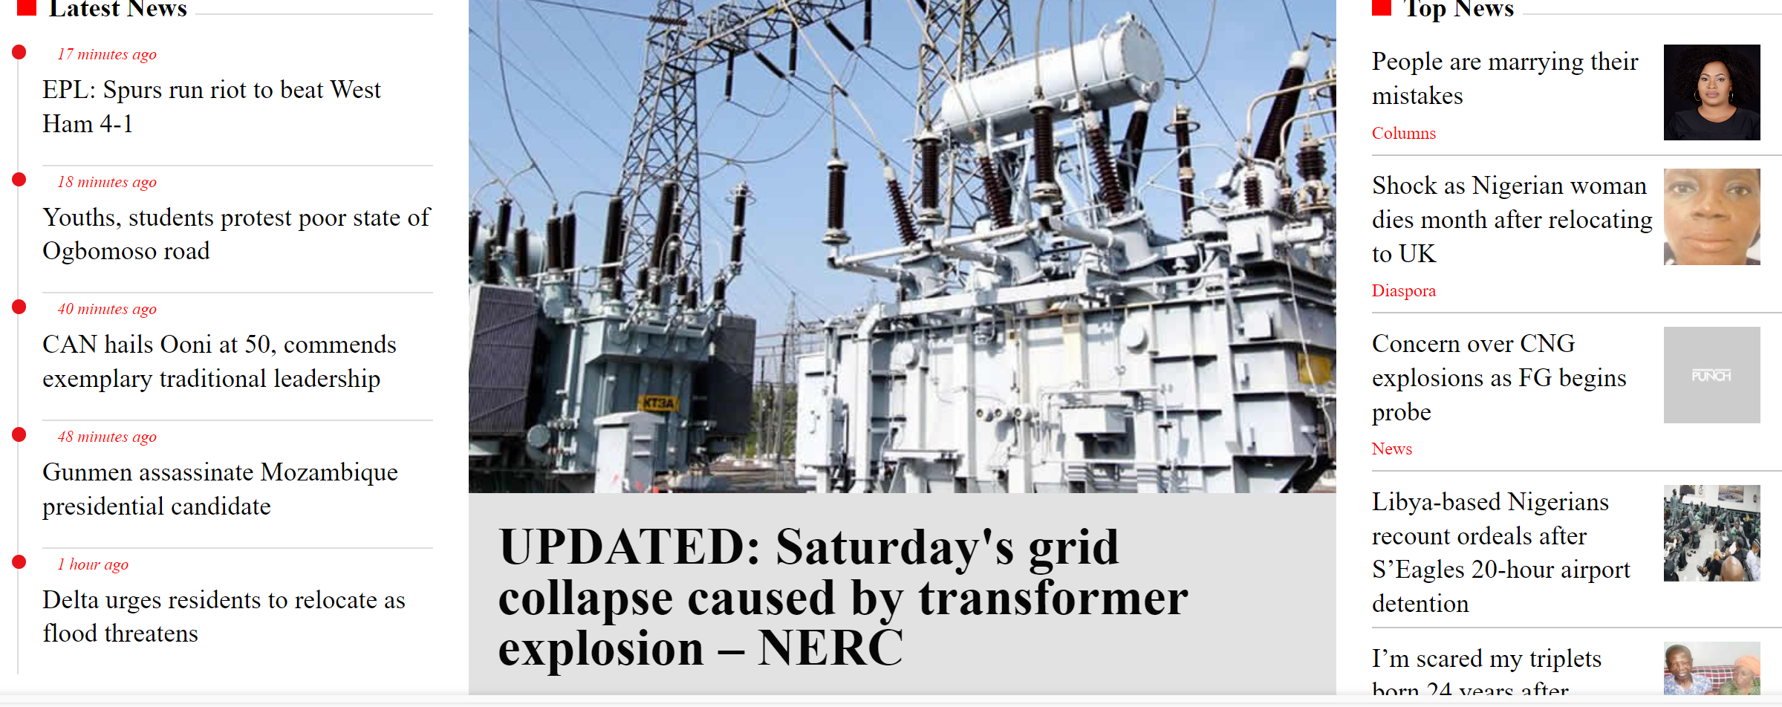

Slide 14
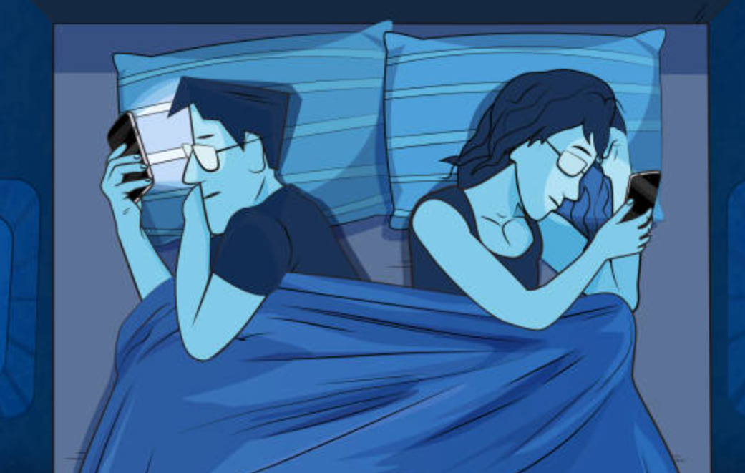
NEGATIVE IMPACT OF TECHNOLOGY AND SOCIAL MIDEA
2) Distraction and Overuse
Fragmented Attention:
Our attention is often pulled in multiple directions. Notifications from our devices,
The need to call friends after a long day,
Using social media as a distraction to avoid dealing with family issues
Proverbs 4:25-27: We must strive to maintain our focus on what truly matters in our lives.
Loving God, our faith in Him, our salvation, the love of family. Others are secondary.
.

Slide 15

NEGATIVE IMPACT OF TECHNOLOGY AND SOCIAL MIDEA
Impact on Physical and Mental Health: Overindulgence in leads to;
Physical ailments: eye strain, headaches, and poor posture.
Mental health issues: Studies link excessive screen time to increased anxiety and feelings of isolation.
Diminished Relationships:
Social media may not be so social.
We loose touch of the value of face to face interactions
Families struggle to have meaningful conversations.
People can’t engage anymore, we prefer to slide into DMs.
We need to prioritize face-to-face connections, fostering community and support.

Slide 16

NEGATIVE IMPACT OF TECHNOLOGY AND SOCIAL MIDEA
3) Comparison and Envy
Social Media Portrayals vs. Reality
Impact on Self-Esteem and Family Dynamics
4) Distraction from Faith
Overuse Leading to Neglect of Spiritual Practices
Competing Interests and Priorities

Slide 17
BALANCING TECHNOLOGY AND SOCIAL MIDEA
How do we strike a balance?
1 Corinthians 9:27 – Discipline, discipline, discipline
Setting Boundaries
Time Limits and Screen Time Management
Family Discussions About Content Consumption and use of gadgets
Encouraging Healthy Engagement
Focusing on Uplifting Content
Participating in Faith-Based Online Communities

Slide 18

Conclusion
It can be nearly impossible if not actually impossible to live a life without the usage of some sort of technology or media.
We should be thankful to God for the many modern conveniences that we enjoy, but we shouldn’t allow for these blessings to be turned into something that dishonors or displeases God.
Finding balance in our media use requires intentionality and discernment.
By setting boundaries and encouraging healthy engagement, we can use them to enrich our lives rather than distract us from our faith. May we ever be mindful and aware as we daily use the technologies that are available to us, and may everything that we do bring glory and honor to the name of our great and awesome God.

