Slide 1
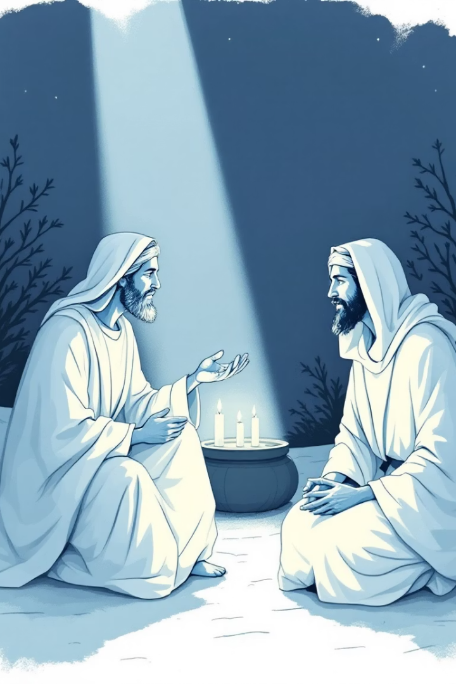
ARE YOU BORN AGAIN?
TEXT: JOHN 3:1-7
By Bro Samuel Ademu

Slide 2
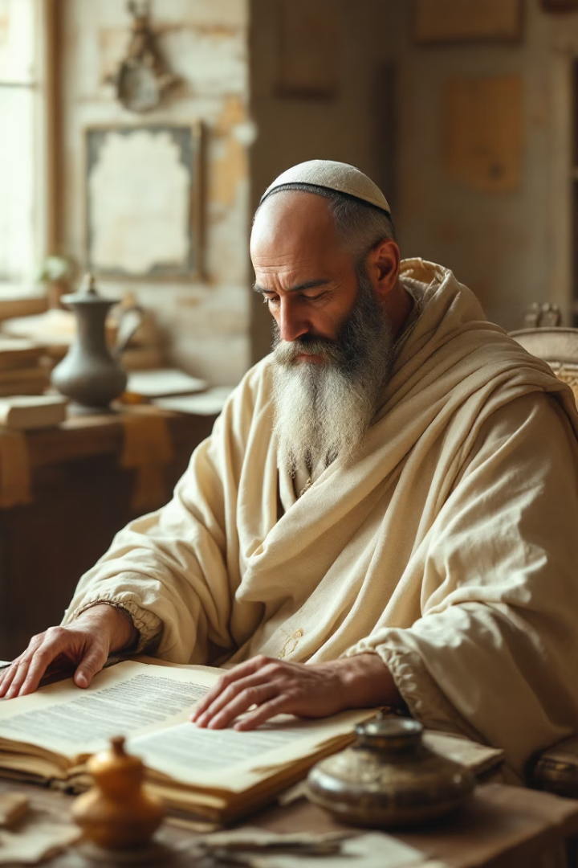
INTRODUCTION
Nicodemus was a Pharisee and a member of the Jewish ruling council (Sanhedrin) who interacted with Jesus in the Gospel of John. He was a defender of Jesus, Nicodemus defended Jesus before the Pharisees (John 7:50-52). He participant in the burial of Jesus', Nicodemus helped Joseph of Arimathea prepare Jesus' body for burial (John 19:38-42).
John 19:38-39 "And after this Joseph of Arimathaea, being a disciple of Jesus, but secretly for fear of the Jews, besought Pilate that he might take away the body of Jesus: and Pilate gave him leave. He came therefore, and took the body of Jesus. 39 And there came also Nicodemus, which at the first came to Jesus by night, and brought a mixture of myrrh and aloes, about hundred pound weight".

Slide 3
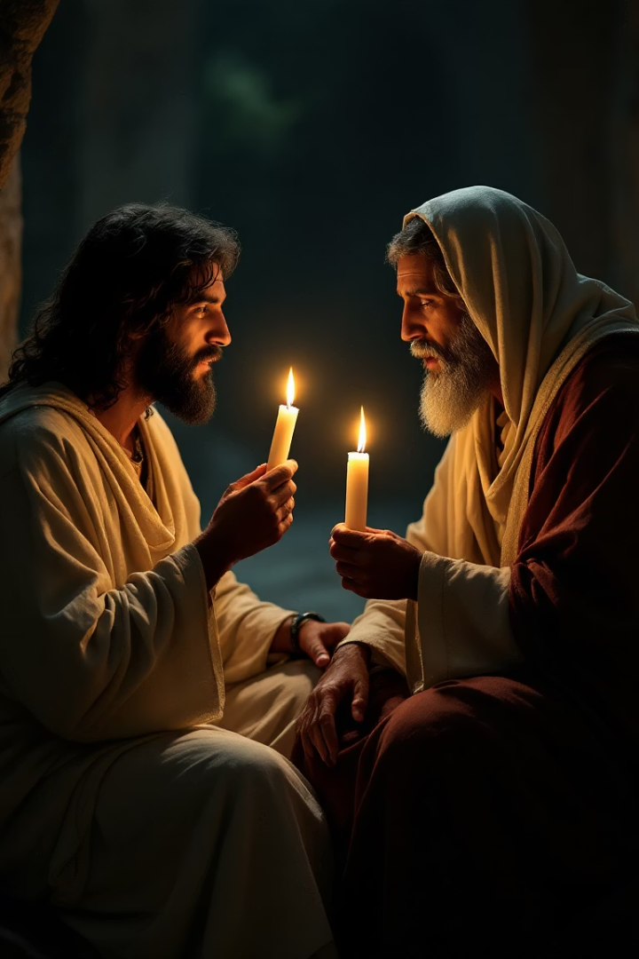
Nicodemus: A Seeker of Truth
As a seeker of truth, Nicodemus came to Jesus at night, seeking to understand His teachings (John 3:1-21). He was curious (spiritual curiosity) about Jesus' message and the kingdom of God. Jesus and Nicodemus were discussing about different thing entire. In verse 2 says, ”The same came to Jesus by night, and said unto him, Rabbi, we know that thou art a teacher come from God: for no man can do these miracles that thou doest, except God be with him”.
But Jesus turned and said to him to be born again; Jesus knew something important was lacking in him, hence there was a need to change the conversation. What a disappointment if you are in the shoes of this man, you leave your house to go and praise and eulogize someone and this is what you got instead of appreciation.

Slide 4

WHAT DOES IT MEAN TO BE BORN AGAIN?
It is a new beginnings and spiritual rebirth: the concept of being “born again” is central to Christianity. It’s not a physical birth, but a spiritual transformation that will make us to:
1. Recognizing our need: We are all sinners in need of salvation (Romans 3:23). “For all have sinned, and come short of the glory of God”.
2. Faith in Jesus Christ: Believing in Jesus Christ is the only way to experience spiritual rebirth (John 14:6). Jesus saith unto him, I am the way, the truth, and the life: no man cometh unto the Father, but by me.
3. Transformation: Being born again involves a transformation of our hearts and lives (2 Corinthians 5:17). Therefore if any man be in Christ, he is a new creature: old things are passed away; behold, all things are become new.

Slide 5
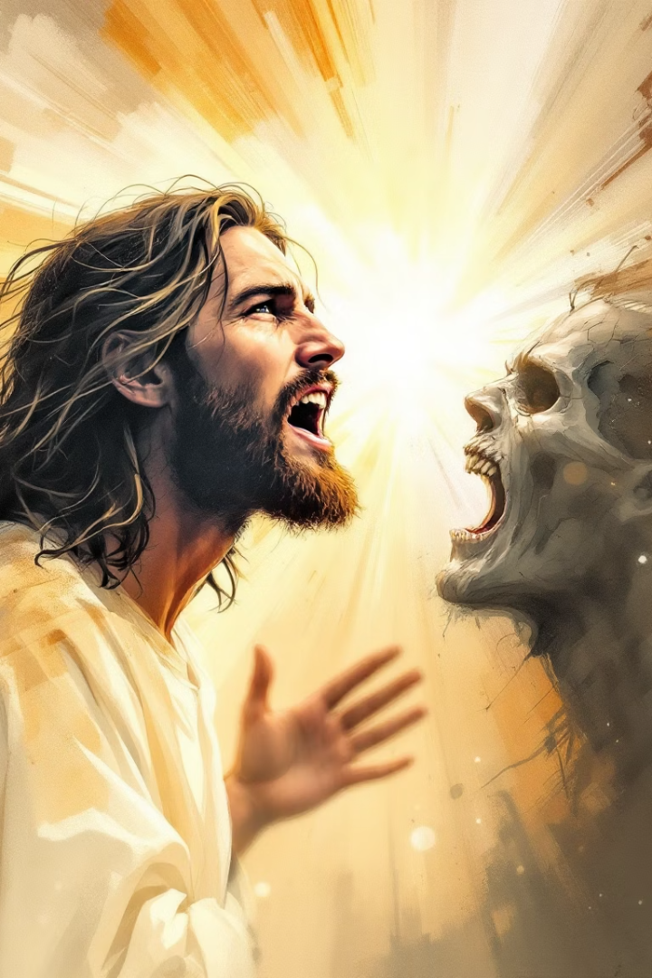
CHARACTERISTICS OF THE UNBORN AGAIN
A child in a womb: a child in a womb is in darkness, it cannot do anything meaningful or beneficial to the mother. Unborn child is not counted as a member of the family, if you are outside Christ you will not be counted also when Christ comes.
(Matthew 6:23) “But if thine eye be evil, thy whole body shall be full of darkness. If therefore the light that is in thee be darkness, how great is that darkness”! This is how some people are in the house of God, they do things completely unchristian, and they are not bothered even if you point it out to them from the Bible.

Slide 6
CHARACTERISTICS OF THE UNBORN AGAIN
A child in a womb is nearer to the mother and further from the mother: (Matthew 15:8).This people draweth nigh unto me with their mouth, and honoureth me with their lips; but their heart is far from me.
This child is within the mother still it’s far from her because when the mother calls, the child cannot hear her. This is the true example of sinner(s) in the Church today.
(John 15:6) “If a man abides not in me, he is cast forth as a branch, and is withered; and men gather them, and cast them into the fire, and they are burned”. A child in a womb is not counted as a member of the family. No Govt. counts children in the womb during census or head counts. You must be born again to inherit the kingdom of God.

Slide 7
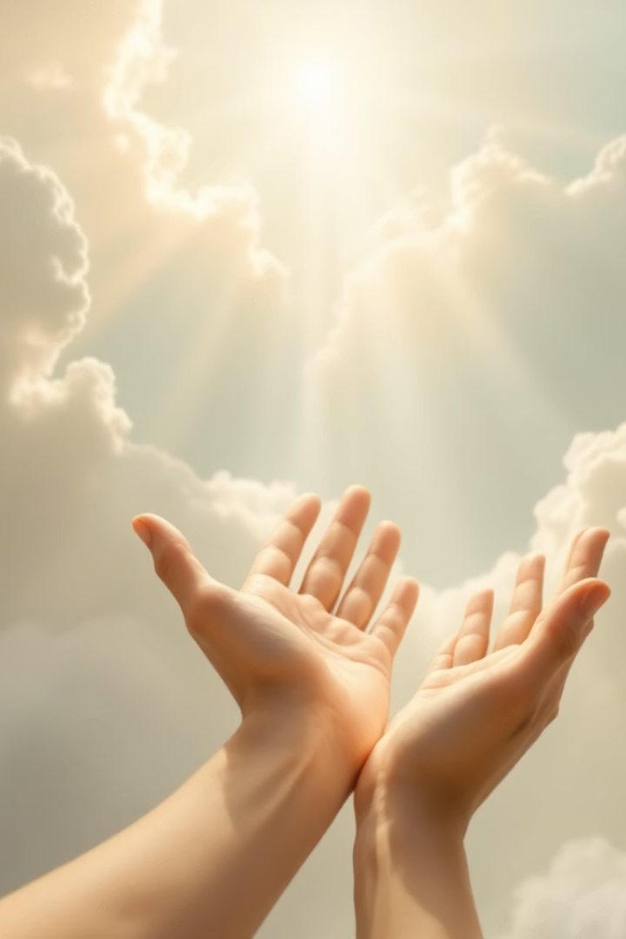
LIFE STYLE OF THE UNBORN AGAIN
Overfamiliarity with the word of God and the things of God: When you get to this point in your life where you feel you know it all, you can predict what God will demand in a given situation without consulting Him, or His word, that is a danger sign that you have derailed.
Such path led to the defeat of King Saul (1 Samuel 13:9-14), the death of Nadab and Abihu (Number 3:4), Uzziah’s terminal leprosy (2Chro. 26:16-21), and the death of Herod (Acts 12:21-23). (Deuteronomy 17:12) tells us that “The man that will do presumptuously …shall die.” Brethren, this calls for watchfulness!

Slide 8
LIFE STYLE OF THE UNBORN AGAIN
They outgrow corrections: “While it is said, today if ye will hear his voice, harden not your hearts, as in the provocation.” (Hebrews 3:15). Read Proverbs 15:10-12 (KJV).
For every action or inaction, there are consequences. This is why you should consider it a great privilege when you have people around you who can correct you whenever you do something wrong so that you do not have to suffer terrible consequences. Unfortunately, some people do not listen to corrections. The Bible refers to such people as servants.
(Proverbs 29:19) “A servant will not be corrected by words: for though he understands he will not answer”.

Slide 9
LIFE STYLE OF THE UNBORN AGAIN
Prayerlessness: (Jude 1:20). “But ye, beloved, building up yourselves on your most holy faith, praying in the Holy Ghost”. Anything short of praying without ceasing is a mistake on the part of the Christian. Prayer is the lifeblood of this journey to Heaven. It connects us to God, opens our heart to hear His corrections and shows our dependence on Him. Anything that makes us put prayer aside is driving us towards self-reliance and self-management. (Psalm 91:1) “He that dwelleth in the secret place of the most High shall abide under the shadow of the Almighty”.

Slide 10
LIFE STYLE OF THE UNBORN AGAIN
Talkativeness: (Proverbs 10:19) “In the multitude of words there wanteth not sin: but he that refraineth his lips is wise”. When a person is given to talking too much, there’s likelihood that there will be exaggerations, understatements, half-truths, and outright lies. You need to guard against this, don’t talk away your destiny brethren. There is no talkative that is not a liar, (show me one that is not a liar and I will show you many that are liars). Read also 2Samuel chapter 1 verse 1 to end.

Slide 11
LIFE STYLE OF THE UNBORN AGAIN
The young son of stranger, an Amelekite lied that he killed King Saul in mount Gilboa. Instead of appreciation for killing the seemingly enemy King David, he died because he lies, he could not control his tongue (Revelation 21:8). “But the fearful, and unbelieving, and the abominable, and murderers, and whoremongers, and sorcerers, and idolaters, and all liars, shall have their part in the lake which burneth with fire and brimstone: which is the second death”.

Slide 12
LIFE STYLE OF THE UNBORN AGAIN
Lack of interest in the things of God: 2Timothy 4:3-4. “For the time will come when they will not endure sound doctrine; but after their own lusts shall they heap to themselves teachers, having itching ears; 4 And they shall turn away their ears from the truth, and shall be turned unto fables”.
These are some of the reasons why people do abominable things without thinking twice. Nakedness everywhere you turn to, even mothers and even grandmothers are caught in the web of indecent dressing nowadays.

Slide 13
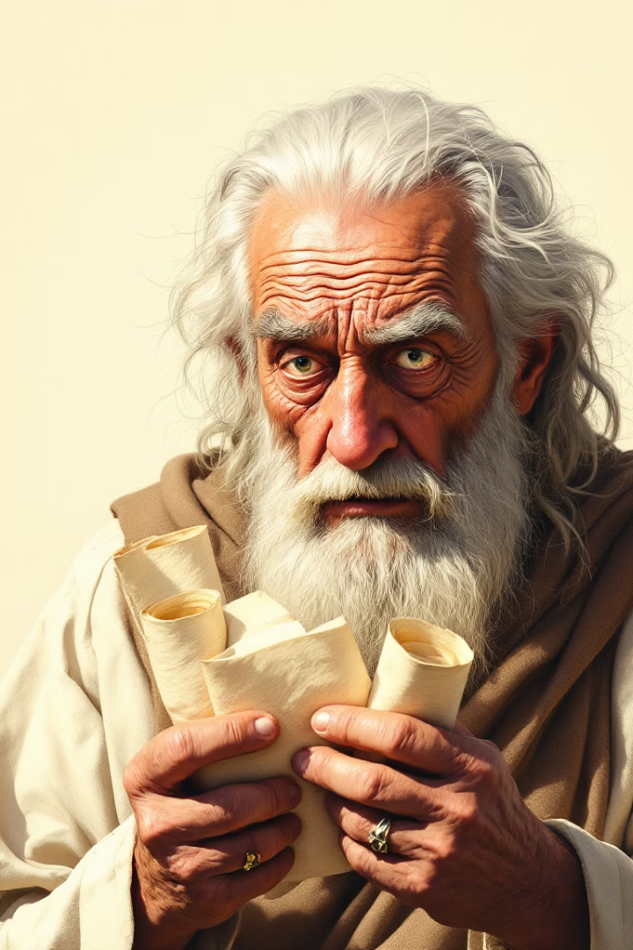
LIFE STYLE OF THE BORN AGAIN - 2 Corinthians 5:17
Therefore if any man be in Christ, he is a new creature: old things are passed away; behold all things are become new.
Conquer by kindness: Jesus' willingness to die on the cross for humanity demonstrates His humility and obedience to God's plan. Jesus' humility and sacrifice serve as a model for Christians, emphasizing the importance of selflessness, obedience, and love.

Slide 14
LIFE STYLE OF THE BORN AGAIN - 2 Corinthians 5:17
1. Selfless sacrifice: Jesus gave His life for the salvation of humanity, showing ultimate love and humility.
2. Obedience to God: Jesus' sacrifice was an act of obedience to God's plan for redemption.
3. Servant-like attitude: Jesus' actions exemplify a servant-like attitude, prioritizing others' needs over His own.
Scriptures like (Philippians 2:5-8 and John 3:16) highlight Jesus' humility and sacrifice.

Slide 15
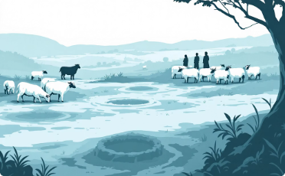
Benefit of kindness - 1Peter 5:6
“Humble yourselves therefore under the mighty hand of God, that he may exalt you in due time”. Humility has a lifting power, you humble your way to the top in life. Abraham benefited from the act of kindness when he was to bury his wife Sarah in a foreign land as recorded in Gen.23:1 to end.

Slide 16
Benefit of kindness - 1Peter 5:6
Isaac demonstrated humility in Gerar: (Genesis 26:14-22) For he had possession of flocks, and possessions of herds, and great store of servants: and the Philistines envied him. 15 For all the wells which his father's servants had digged in the days of Abraham his father, the Philistines had stopped them, and filled them with earth. 16 And Abimelech said unto Isaac, Go from us; for thou art much mightier than we. 17 And Isaac departed thence, and pitched his tent in the valley of Gerar, and dwelt there. 18 And Isaac digged again the wells of water, which they had digged in the days of Abraham his father; for the philistines had stopped them after the death of Abraham: and he called their names after the names by which his father had called them.

Slide 17
Benefit of kindness - 1Peter 5:6
Paul and Silas showed kindness: (Acts 16:27-28) “And the keeper of the prison awaking out of his sleep, and seeing the prison doors open, he drew out his sword, and would have killed himself, supposing that the prisoners had been fled. But Paul cried with a loud voice, saying, Do thyself no harm: for we are all here”.
Paul and Silas showed high level of kindness and humility in Philippi’s prison. In the olden day, if strip any Roman naked you will be in hot soup for it. Paul and Silas went through all these humiliations in Philippi, a city in ancient Macedonia (modern day Grace). Even Paul as a lawyer didn’t take any action; same Paul that was persecuting the church when he was Saul, what happened here is a power of submitting to the will of God as a born again person.

Slide 18
Benefit of kindness - 1Peter 5:6
I wonder what kind of prison you are in or what problem threatens to defeat you. It’s easy to complain when you are faced with challenges of life. Nevertheless, if you want God to come into your cell like Paul and Silas, you must resist the temptation to complain or grumble. You have to make the decision to pray and praise Him instead.
(Romans 8:35) "Who shall separate us from the love of Christ?
(Romans 8:38-39). Answer it all:

Slide 19
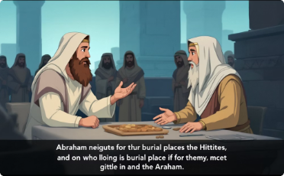
Open to corrections: Hebrews 3:15
“While it is said, today if ye will hear his voice, harden not your hearts, as in the provocation”.
You don’t outgrow corrections brethren, for every action or inaction, there are consequences. You can choose between being corrected by words or by consequences. If you are wise, you will choose to be corrected by words so that you can avoid the consequences that come with doing the wrong things. Those who are wise do not wait for people to correct them.

Slide 20
Open to corrections: Hebrews 3:15
Rather, they regularly ask the people around them for feedback to know if they are on the right track or not. In Matthew 16:13, Jesus Christ asked His disciples, "Who do men say that I am?" In other words, He was asking, "Based on my character and words, what is the impression that I give people about myself?" It is important that you regularly give people the opportunity to tell you what they think of you, especially when you are a leader. You can make it anonymous so that they can give you honest feedback.

Slide 21
Open to corrections: Hebrews 3:15
It is quite possible for someone to grow to a level where people begin to say he or she is infallible, even in situations where the fellow knows that he or she has erred. It is important to avoid this pitfall and ensure that you still have people around you who will always tell you the truth. You should never outgrow corrections. Even when people criticise you with evil intentions, you can ignore their motives and listen to see if there is really something that you need to correct or improve on.

Slide 22
Caring for others: Gal. 6:2
“Bear ye one another’s burdens, and so fulfill the law of Christ”. (Acts 2:44-45) And all that believed were together, and had all things common; 45 And sold their possessions and goods, and parted them to all men, as every man had need.

Slide 23
WHY YOU MUST BE BORN AGAIN
Mark 16: 16 He that believeth and is baptized shall be saved; but he that believeth not shall be damned.
To be translated into the kingdom of dear son (Jesus): Colossians 1:13 Who hath delivered us from the power of darkness, and hath translated us into the kingdom of his dear Son
It is part of salvation: (John 3:7) Marvel not that I said unto thee, Ye must be born again.
To inherit the kingdom of God: (Galatians 5:19-21) Now the works of the flesh are manifest, which are these; Adultery, fornication, uncleanness, lasciviousness, 20 Idolatry, witchcraft, hatred, variance, emulations, wrath, strife, seditions, heresies, 21 Envyings, murders, drunkenness, revellings, and such like: of the which I tell you before, as I have also told you in time past, that they which do such things shall not inherit the kingdom of God.

Slide 24
CONCLUSION
“While it is said, today if ye will hear his voice, harden not your hearts, as in the provocation.” (Hebrews 3:15).
Friends and visitors in our mist, are you still harden your hearts? What else do you want to hear or how long do you want to hear before you give your life to Christ through water baptism?
Hearing His words as you have just heard (Rom.10:17).
Believing in Him (Rom.10:8-9; Acts 8:37).
Repenting of your sins (Acts 17:30)
Confessing Him as your Lord and the son of the living God (Rom 10:9; Matt 10:32
Being baptized by water immersion (Rom 6:3-4; Gal 2:27)
Finally you will be added to his Church (Acts 2:42-47)
Many thanks and God bless you for your time

